Slide 1
Evaluating a Process Change for Effectiveness, Safety, Waste Generation, & Air Emissions Reduction. CASE STUDY: Improving Dip Room Cleaning Protocol
Kale Walch, Hexcel and Mike Sherer, Trinity Consultants

Slide 2
Facility Description
Manufacturing of honeycomb blocks
On site since 1966
Dip Room
RTOs for control of VOCs
CAA permits
PSD construction permit requiring BACT controls
Title V operating permit
RCRA
Large Quantity Generato

Slide 3
Honeycomb

Slide 4
Historic Process
Acetone used for floor cleaning
No removal of liquid / resin material
Disadvantages
Resin build up
Lower Explosive Limit (LEL) sensors registered high during cleaning
Sensors are actually measuring Lower Flammable Limit (LFL)
Advantages
No waste generated
Acetone evaporated quickly
Smoothed out floor

Slide 5
Project Scope
Project team
Operators, EH&S Staff, Consultant
Find a new chemical
Tested alternative did not work
Changed to process improvement
Kept acetone as the cleaning solvent
Still completed at shift change

Slide 6
Changes
100% acetone replaced with 70% water / 30% acetone
Implementation Problems
Had to ground bucket
Had to purchase a ringer
Floor changed color and became bumpy
Created a hazardous waste
Added a satellite drum for collection
Moved to purchase of pre-diluted mix
Purchased hand pump to dispense

Slide 7
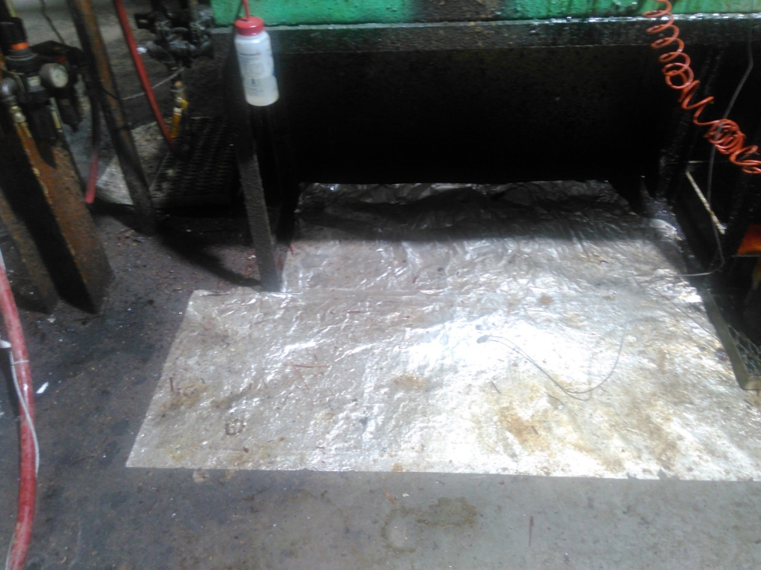
Dip Room

Slide 8
Changes (continued)
Implementation Successes
Identified and resolved historic safety risks
Grounding
LEL sensor impact reduced
Floor became cleaner and cleaner
Resolved roughness issue over time

Slide 9
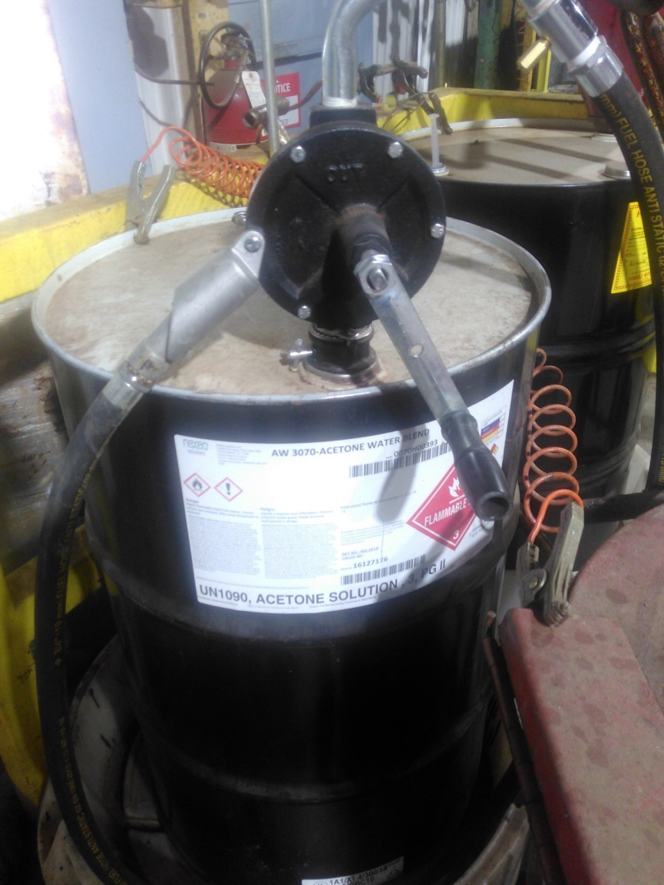
Cleaning Product and Waste

Slide 10
Changes (continued)
Implementation benefits
Estimated acetone emission reduction of 12 tpy
Acetone is not a regulated air pollutant, thus not reflected in the annual emission inventory
Chemical use cost reduction of $32,000 per year (based on 50 week a year)
Recently complemented on dip room cleaning during ISO audit
Utilized to clean other areas
Implementation disadvantages
Hazardous waste disposal cost
Some areas, i.e. tank edges, still need cleaning with 100% acetone

Slide 11
Lesson Learned
Had to convince long time employees change is possible
Involved operators in scoping, design and implementation
Changes made during implementation required
Results improved over time

